Slide 1
Fractals
A tribute to Benoît Mandelbrot
(1924-2010)
Math Club 11/01/2010

Slide 2
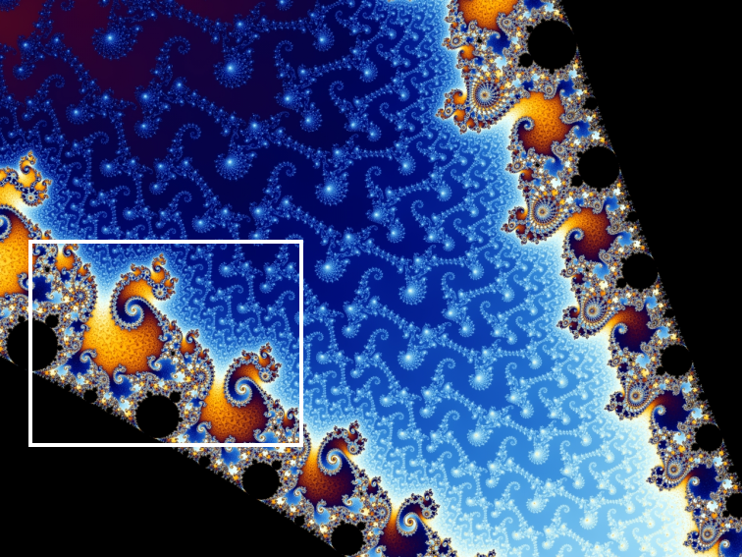
What is a fractal?
A fractal is a shape that is self-similar (small parts of a fractal look like the whole fractal)
Usually a fractal has finite area but infinite perimeter

Slide 3
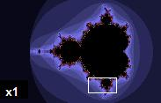
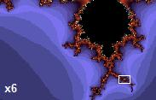
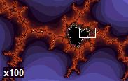
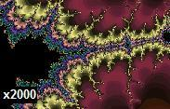
Mandelbrot Set

Slide 4
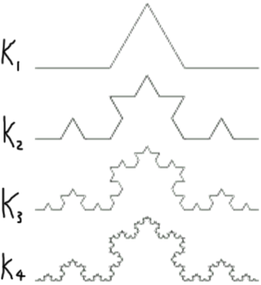
Koch Curve
A simple problem:
How many line segments are in K_{n}?
K₀ has 1 segment
K₁ has 4 segments
K₂ has 16 segments
K_{n+1} has 4 times as many as K_{n}
Therefore K_{n} has 4^{n} segments.
Another simple problem:
What is the length of K_{n}?
K₀ is 1 unit long
A segment in K_{n+1} is 1/3 as long as one in K_{n}.
Therefore a segment in K^{n} has length (1/3)^{n}
K_{n} has 4^{n} segments
Length of K_{n} = 4^{n} * (1/3)^{n}
Which is equal to (4/3)^{n}.

Slide 5
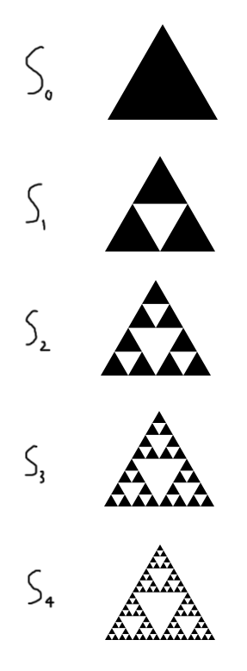
Sierpinski Triangle
Problem:
How many black triangles are in S_{n}?
1 triangle in S₀
3 black triangles in S₁
S_{n+1} has 3 times more triangles than S_{n}
So S_{n} has 3^{n} triangles.
Another problem:
What is the area of S_{n}?
S₀ has an area of 1
Each time, 1/4 of the area is removed
So area of S_{n+1} equals 3/4 * S_{n}
S_{n} has area of (3/4)^{n}

Slide 6
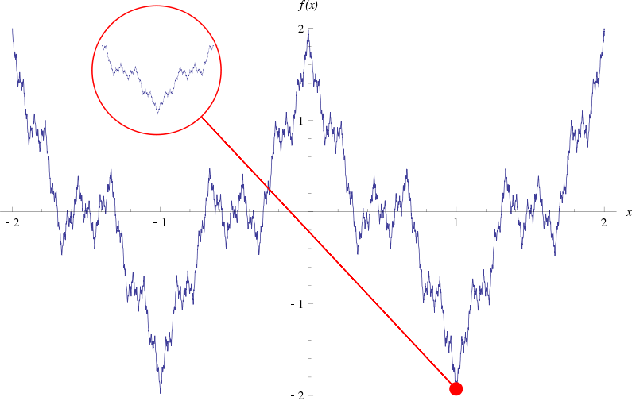
Weierstrass function: even functions can be fractals!

Slide 7
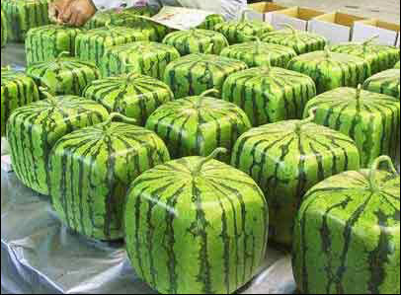
Dimensions
Dimension = 1: Line
Dimension = 2: Square
Dimension = 3: Cube

Slide 8
But why?
Why is a square 2-dimensional and a cube 3-dimensional?
1 square
Side length = 1
A square can be broken down into 4 identical pieces with a magnification of 2.
4 squares
Side length = 0.5

Slide 9
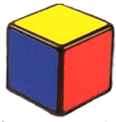
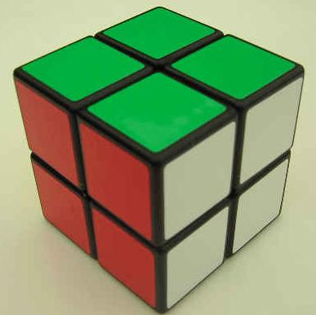
Now for cubes
1 cube
Side length = 1
A cube can be broken down into 8 identical pieces, each with a magnification of 2.
8 cubes
Side length = 0.5

Slide 10
Calculating Dimension
Formula for dimension:
D = log(4)/log(2) = 2
D = log(8)/log(2) = 3

Slide 11
Koch Curve
What is the dimension?
Each piece is split into 4 pieces
Each piece is smaller by factor of 3
Dimension = log(4)/log(3) ≈ 1.26

Slide 12
Sierpinski Triangle
What is the dimension?
Each triangle becomes 3 smaller triangles
Each triangle is smaller by factor of 2
Dimension = log(3)/log(2) ≈ 1.58

Slide 13
Cantor Set
What is the dimension?
2 pieces, each smaller by factor of 3
Dimension = log(2)/log(3) ≈ 0.63

Slide 14
Vicsek Fractal
What is the dimension?
A cross becomes 5 crosses
Each cross is 3 times smaller
Dimension = log(5)/log(3) ≈ 1.46

Slide 15
Menger Sponge
What is the dimension?
Cube becomes 20 cubes, each 3 times smaller
Dimension = log(20)/log(3) ≈ 2.73

