Slide 1
Introduction to Functional Equations
3/07/2011

Slide 2
How do you solve them?
A functional equation is an equation where the variable you want to find is a function.
For example, suppose for every number $x$, $f\left(f\left(x\right)\right)=x$.
Then $f\left(x\right)=−x$ is one solution.
To fully solve a functional equation, we want to find all solutions to a functional equation, and prove that no others exist.

Slide 3

Really Easy Problem 1
Find all functions $f$ if $f\left(xy\right)=f\left(x\right)+f(y)$ for all reals.
Answer: $f\left(x\right)=0$.
Let $y=0,$ then $f\left(0\right)=f\left(x\right)+f(0)$.
So $f\left(x\right)=0$.

Slide 4
Really Easy Problem 2
Find all functions $f$ such that $f\left(x+y\right)=f\left(x\right)+f(y)$ for all rational numbers. (Cauchy’s Equation)
Plugging $x=y=0$ gives $f\left(0\right)=0$.
If we set $y=−x$, then $f\left(−x\right)=−f(x)$.
If we set $y=x$, then $f\left(2x\right)=2f(x)$; similarly $f\left(nx\right)=nf(x)$ by induction.
Write $x=\frac{m}{n}$. Then $f\left(x⋅n\right)=f(m⋅1)$ or $nf\left(x\right)=mf(1)$; $f\left(x\right)=\frac{m}{n}f(1)$.
If $f\left(1\right)=c$, then the solution is $f\left(x\right)=cx$.

Slide 5
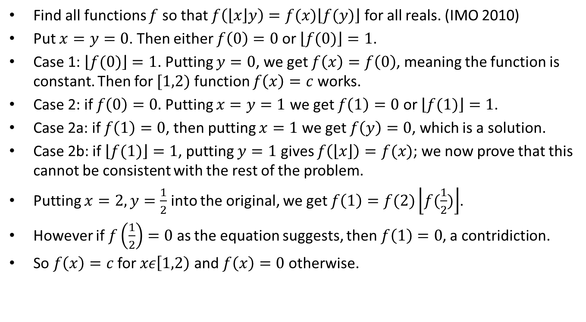
Really Easy Problem 3
Find all functions $f$ so that $f\left(\left\lfloor x\right\rfloor y\right)=f(x)\left\lfloor f(y)\right\rfloor$ for all reals. (IMO 2010)
Put $x=y=0$. Then either $f\left(0\right)=0$ or $\left\lfloor f(0)\right\rfloor =1$.
Case 1: $\left\lfloor f(0)\right\rfloor =1$. Putting $y=0$, we get $f\left(x\right)=f\left(0\right)$, meaning the function is constant. Then for $[1,2)$ function $f\left(x\right)=c$ works.
Case 2: if $f\left(0\right)=0.$ Putting $x=y=1$ we get $f\left(1\right)=0$ or $\left\lfloor f(1)\right\rfloor =1$.
Case 2a: if $f\left(1\right)=0$, then putting $x=1$ we get $f\left(y\right)=0$, which is a solution.
Case 2b: if $\left\lfloor f(1)\right\rfloor =1$, putting $y=1$ gives $f\left(\left\lfloor x\right\rfloor \right)=f(x)$; we now prove that this cannot be consistent with the rest of the problem.
Putting $x=2, y=\frac{1}{2}$ into the original, we get $f\left(1\right)=f(2)\left\lfloor f(\frac{1}{2})\right\rfloor$.
However if $f\left(\frac{1}{2}\right)=0$ as the equation suggests, then $f\left(1\right)=0$, a contridiction.
So $f\left(x\right)=c$ for $xε\left[1,2\right)$ and $f\left(x\right)=0$ otherwise.

