Slide 1
Problem-Solving Techniques (part one)
HWW Math Club Meeting (April 4, 2011)
Presentation by Julian Salazar

Slide 2
NO CALCULATORS.

Slide 3
Intro: Cool number, bro
In this problem we deduce certain properties of the number 314159265.
Prove that 45 | 314159265.
Calculate ⌈ log₁₀(314159265) ⌉.
What is the 314159265th derivative of sin(x)?

Slide 4
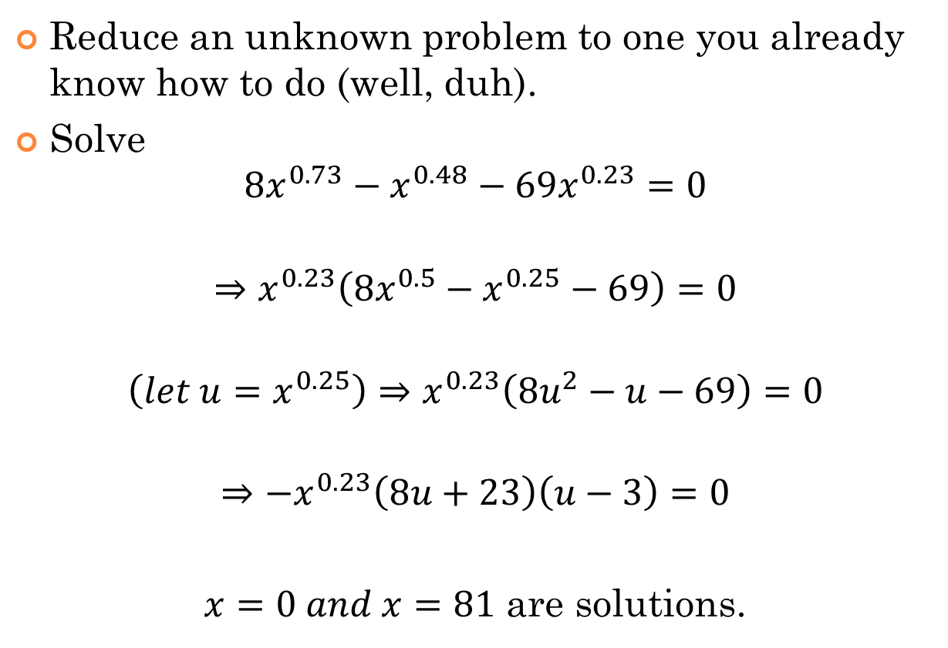
Approach 1: Teakettle Principle
Reduce an unknown problem to one you already know how to do (well, duh).
Solve
$$8x^{0.73}−x^{0.48}−69x^{0.23}=0$$
$$⇒x^{0.23}\left(8x^{0.5}−x^{0.25}−69\right)=0$$
$$\left(let u=x^{0.25}\right)⇒x^{0.23}\left(8u^{2}−u−69\right)=0$$
$$⇒{−x}^{0.23}\left(8u+23\right)\left(u−3\right)=0$$
$x=0 and x=81$ are solutions.

Slide 5
Protip: Graphing is Cool
How many real solutions are there to the equation:
$$x^{100}−{4^{x}∗x}^{98}−x^{2}+4^{x}=0?$$
$$⇒x^{98}\left(x^{2}−4^{x}\right)−\left(x^{2}−4^{x}\right)=0$$
$$⇒\left(x^{98}−1\right)\left(x^{2}−4^{x}\right)=0$$
$x^{98}−1=0$ gives two real solutions, $x=±1$.
$x^{2}−4^{x}$ factored gives $\left(x−2^{x}\right)\left(x+2^{x}\right)$, not very helpful, so we graph!
$∴$ There are three real solutions. $∎$

Slide 6
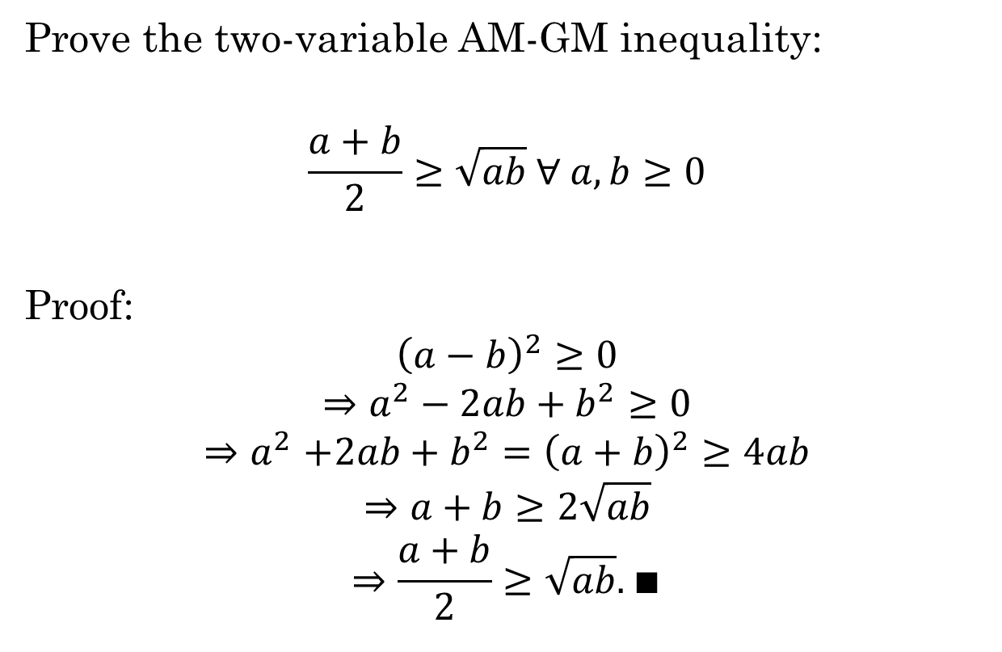
Approach 2: Work Backwards, Write Forwards
Prove the two-variable AM-GM inequality:
$$\frac{a+b}{2}≥\sqrt{ab} ∀ a,b≥0$$
Proof:
$${\left(a−b\right)}^{2}≥0$$
$$⇒a^{2}−2ab+b^{2}≥0$$
$${⇒a}^{2}+2ab+b^{2}={\left(a+b\right)}^{2}≥4ab$$
$$⇒a+b≥2\sqrt{ab}$$
$$⇒\frac{a+b}{2}≥\sqrt{ab}. ∎$$

Slide 7
Protip: When all else fails…
(Hypatia 2007) Cities A,B,C,D,E are all connected to each other. Penny starts at A, visits all cities, then returns to A. If her route is of the form A→__→__→E→__→A, how many possible routes are there?
Solution (this is an official one!):
List the possibilities: A→B→C→E→D→A, A→B→D→E→C→A, A→C→B→E→D→A, A→C→D→E→B→A, A→D→B→E→C→A, A→D→C→E→B→A
Therefore there are 6 possible routes. $∎$

Slide 8
Approach 3: Look Before you Leap
Figure out what you want and how you’re going to get it.
(Euclid 2002): Three metal rods of lengths 9, 12, and 15 and negligible widths are welded to form a right-angled triangle held horizontally. A sphere of radius 5 sits on the triangle so that it is tangent to each rod. How high is the top of the sphere from the plane of triangle?

Slide 9
Approach 3: Look Before you Leap
We want the height of sphere above the triangle
Thus we want where on sphere at which the triangle is tangent to the sphere
This would be the incircle (the unique circle inscribed in triangle)
Tasks:
Find the incircle’s unique radius (the inradius)
Find where along the sphere that radius occurs
Find height from there to the top of the sphere

Slide 10
Approach 3: Look Before you Leap
$A=rs$
$r_{i}=\frac{A}{s}=\frac{bh}{2s}=\frac{\left(9\right)\left(12\right)}{2\left(\frac{9+12+15}{2}\right)}=3$
$r_{s}=5, r_{i}=3$ so $h=4$ (to center of sphere)
The other half of the circle has height = 5, so
The top of the sphere is 9 units above the plane of the triangle.

Slide 11

TEH ENDS (for nao)
Cool Inequality, Bro:
Prove $\left(x+y\right)\left(y+z\right)\left(x+z\right)≥8xyz$ for non-negative $x,y,z$.
Sample problem covered next time:
Let $S(n)$ be the digit sum function.
Find $S\left(S\left(S\left(S\left({4444}^{{4444}^{4444}}\right)\right)\right)\right)$.

