Slide 1
Proofs
Without
Words
Math Club 10/24
Powerpoint Templates

Slide 2
Try proving these facts:
$A=\frac{1}{2}bh$
$π>3$
$A=πr^{2}$
$A=rs$
$1+2+…+n=\left({n+1 \atop 2}\right)$
$1^{3}+2^{3}+…+n^{3}={\left(1+2+…+n\right)}^{2}$(Nicomachus’s theorem)
$h_{1}+h_{2}+…+h_{n}=n^{3}$
$\frac{a+b}{2}≥\sqrt{ab}$ (AM-GM)
Sum of first $n$ odd numbers is $n^{2}$.
$\operatorname{atan}{1+\operatorname{atan}{2+\operatorname{atan}{3=π}}}$
A 8x8 chessboard with a black and white square removed can be tiled with 2x1 dominoes.

Slide 3
$$A=\frac{1}{2}bh$$

Slide 4
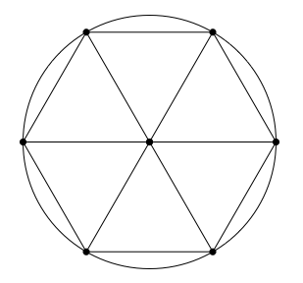
$$π>3$$

Slide 5
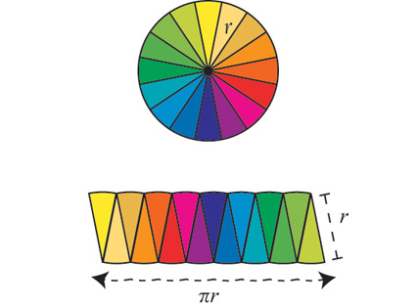
$$A=πr^{2}$$

Slide 6
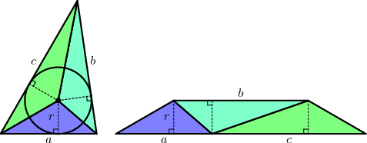
$$A=rs$$

Slide 7
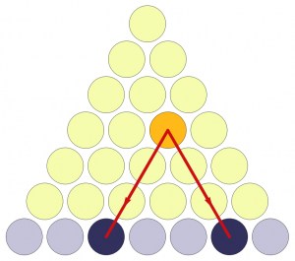
$$1+2+…+n=\left({n+1 \atop 2}\right)$$

Slide 8
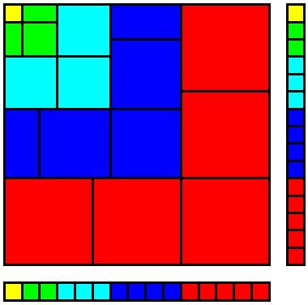
$$1^{3}+2^{3}+…+n^{3}={\left(1+2+…+n\right)}^{2}$$

Slide 9
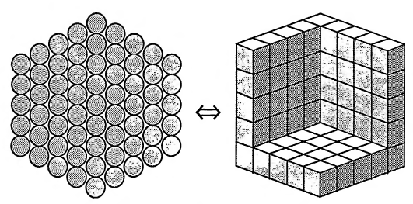
$$h_{1}+h_{2}+…+h_{n}=n^{3}$$

Slide 10
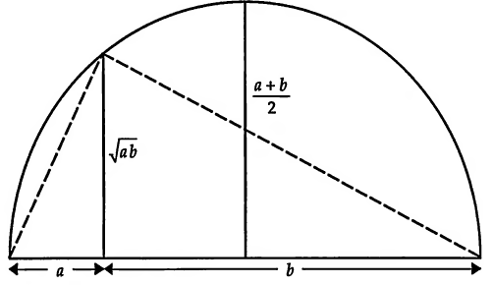
$$\frac{a+b}{2}≥\sqrt{ab}$$

Slide 11
Sum of first n odd numbers is n²

Slide 12
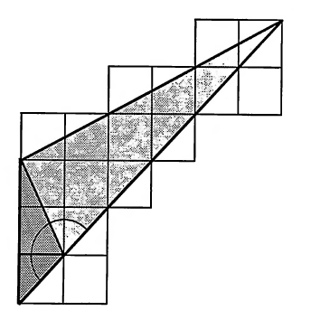
$$\operatorname{atan}{1+\operatorname{atan}{2+\operatorname{atan}{3=π}}}$$

Slide 13
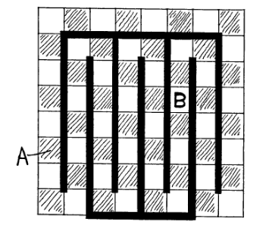
A 8x8 chessboard with a black and white square removed can be tiled with 2x1 dominoes

