Slide 1
Random Number Generators
Math club 12/06/2010

Slide 2
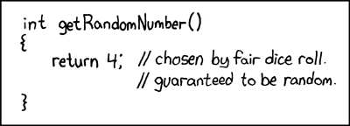
What are random numbers?
1, 3, 5, 7, 9, 11, …?
3, 7, 0, 7, 7, 4, 1, 5, 6, 1, 7, 8, 5 …?
44, 22, 16, 33, 67, 29, 68, 38, 49, 89, …?
4, 4, 4, 4, 4, 4, 4, 4, …?

Slide 3
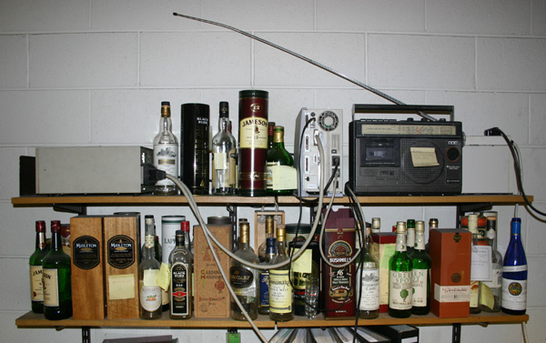
How do we generate random numbers?
Simple. Hook up a computer to a radio that detects atmospheric noise and converts them into numbers.

Slide 4
Well without a radio…
You can’t.
But on the other hand, there’s pseudorandom number generators…

Slide 5
Jason Gin’s faulty Diceroll RNG
x = rand()
y = rand()
r = x * y * 100
return round(r)
rand() gives a random real from 0 to 1, and round() rounds a real to the nearest integer.
Jason is getting the number 100 less frequently than he should. What is wrong with his code?

Slide 6
Mathematical analysis of jason’s rng
What is the chance of Jason’s function returning 100?
$xy ≥0.995$
$y≥\frac{0.995}{x}$
If $x<0.995$ then it is impossible for any $y$.
If $x≥0.995$ then $y$ has a $1−\frac{0.995}{x}$ chance.
$\int_{0.995}^{1}{1−\frac{0.995}{x}}dx$
Integral is $x−0.995 \text{ln}\left(x\right)+C$
$=1−0.995\text{ln}\left(1\right)−0.995+0.995\text{ln}\left(0.995\right)≈0.00001252$
About once every 79867 trials.

Slide 7

Park-miller RNG
$$x_{k+1}=g⋅x_{k }\text{mod} n$$
Very simple.
Let’s say $x_{0}=2$, $g=7$, and $n=15.$
$x_{1}=14$
$x_{2}=8$
$x_{3}=11$
2, 14, 8, 11, …

Slide 8
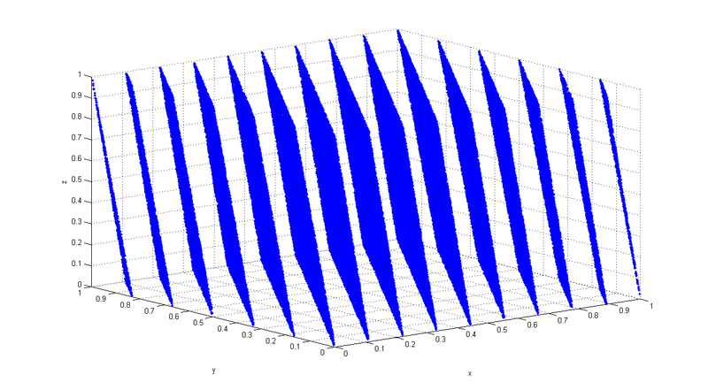

randu
$$x_{k+1}=65539x_{k} \text{mod} 2^{31}$$
Above: 100,000 supposedly ‘random’ points
What went wrong?

Slide 9
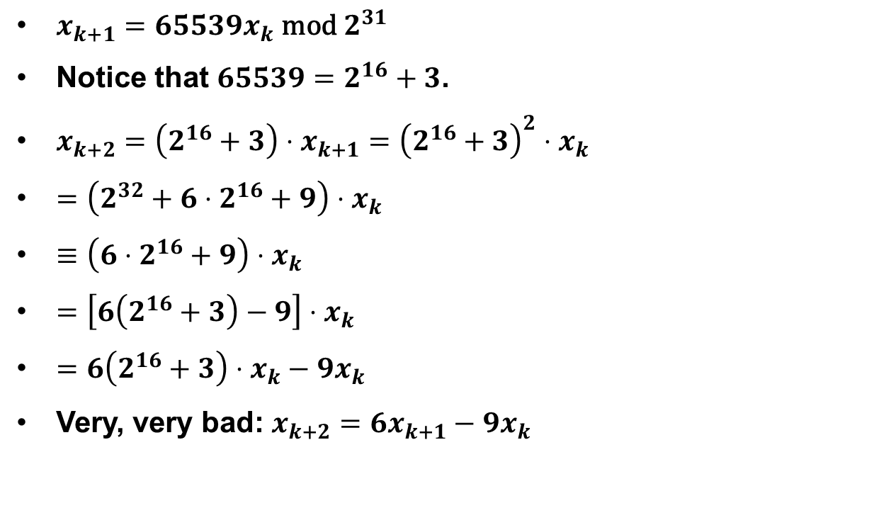
Mathematical analysis of randu
$x_{k+1}=65539x_{k} \text{mod} 2^{31}$
Notice that $65539=2^{16}+3$.
$x_{k+2}=\left(2^{16}+3\right)⋅x_{k+1}={\left(2^{16}+3\right)}^{2}⋅x_{k}$
$=\left(2^{32}+6⋅2^{16}+9\right)⋅x_{k}$
$≡\left(6⋅2^{16}+9\right)⋅x_{k}$
$=\left[6\left(2^{16}+3\right)−9\right]⋅x_{k}$
$=6\left(2^{16}+3\right)⋅x_{k}−9x_{k}$
Very, very bad: $x_{k+2}=6x_{k+1}−9x_{k}$

Slide 10
Linear congruential RNG
$$x_{k+1}=(g⋅x_{k }+c) \text{mod} n$$
Standard random number generator in many programming languages
Java – $\left(g,c\right)=(25214903917,11)$
Glibc – $\left(g,c\right)=(1103515245,12345)$
Microsoft Visual C++ – $\left(g,c\right)=(214013,2531011)$

Slide 11
What about X_0?
$$x_{k+1}=(g⋅x_{k }+c) \text{mod} n$$
What is $x_{0}$?
Also known as the seed.
Current system time, or sometimes hardware.

Slide 12
For the master number-theorist
$$x_{k+1}=(g⋅x_{k }+c) \text{mod} n$$
A good random number generator has a long period (number of terms before it starts repeating).
Explain why it is best if $c⊥n$
Explain why it is best if $g−1$is divisible by all prime factors of $n$.
Suppose $4|n$. Explain why it is best if $g≡1 \text{mod} 4$.

