Slide 1
Sorting Algorithms
(includes some really ridiculous ones)
(may come with demonstrations)
Math Club 2/13/2012
Powerpoint Templates

Slide 2
Big O Notation
Shlemiel gets a job as a street painter, painting the dotted lines down the middle of the road. On the first day he takes a can of paint out to the road and finishes 300 yards of the road. "That's pretty good!" says his boss, "you're a fast worker!" and pays him a kopeck.
The next day Shlemiel only gets 150 yards done. "Well, that's not nearly as good as yesterday, but you're still a fast worker. 150 yards is respectable," and pays him a kopeck.
The next day Shlemiel paints 30 yards of the road. "Only 30!" shouts his boss. "That's unacceptable! On the first day you did ten times that much work! What's going on?"
"I can't help it," says Shlemiel. "Every day I get farther and farther away from the paint can!"

Slide 3
Big O Notation
We use Big-O notation to describe how long it takes to do a task, in relation to the “size” of the task.
$O(1)$ means that no matter how big a task is, it takes the same amount of time to do.
$O(n)$ means that the time it takes to do something varies directly with its size.
$O(n^{2})$ means that if the size of the task increases by 2, then it takes 4 times the time to do.
And so on…

Slide 4
First attempt: Gravity
We want to sort a deck of cards.
So we toss all the cards in the air, pick them all up, and see if it’s sorted.
If it’s not sorted, repeat.
Question is, how long does this take?
$n!$ arrangements, and $n$ time to check one
Answer: $O(n×n!)$

Slide 5
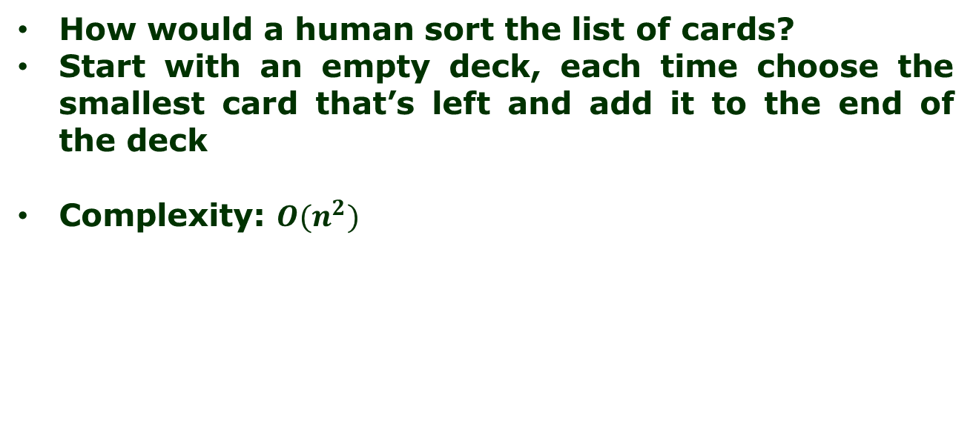
Second attempt: Insetion Sort
How would a human sort the list of cards?
Start with an empty deck, each time choose the smallest card that’s left and add it to the end of the deck
Complexity: $O(n^{2})$

Slide 6
Third attempt: Merge Sort
Suppose that you have two part-decks that were already sorted (maybe with insertion sort)
It’s easy to combine the two decks into one single sorted deck!
Complexity: $O(n log n)$

Slide 7
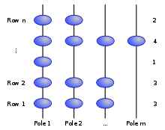
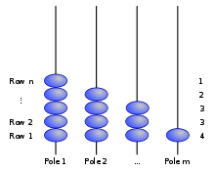

Best yet attempt: Gravity (a different one)
Suppose you want to sort the integers [2,4,1,3,3]
Complexity: $\sqrt{n}$

