Slide 1
COMC 2010 Unofficial Solutions
Henry Wise Wood Math Club 11/29/2010

Slide 2
1. Find $\frac{{\left(9+5\right)}^{2}−{\left(9−5\right)}^{2}}{9×5}$

Slide 3
2. Solve $x−\left(8−x\right)=8−(x−8)$

Slide 4
3. Three circles centered at O, CD passes through B, A, O. OA=2, OB=4, OC=6, then what is the area of the shaded region?

Slide 5
4. How many digits in $\frac{(3.1×{10}^{7})(8×{10}^{8})}{2×{10}^{3}}$

Slide 6
5. What point on $y=x$ is closest to $P(−3,9)$?

Slide 7
6. On a exam, the average of students who studied was 90%, the average of students who did not study was 40%, and the class average was 85%. What percentage of the class did not study?

Slide 8
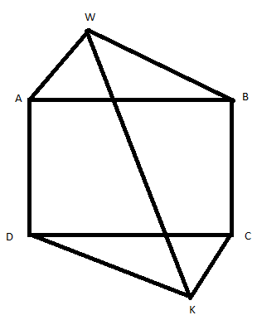
7. ABCD is a rectangle, AB=20, BC=10, WA=KC=12, WB=KD=16, find WK.

Slide 9
8. Solve $\left(x^{2}+3x+2\right)\left(x^{2}−2x−1\right)\left(x^{2}−7x+12\right)+24=0$

Slide 10
1a. Find C
A | A | 50
B | C | 44
37 | 57

Slide 11
1b. Find n
D | D | D | 30
F | F | E | 55
F | E | E | 50
50 | n | 40

Slide 12
1c. Find P+Q
P | Q | T | R | 20
Q | P | T | R | 20
R | R | R | T | 33
T | T | T | R | 19
20 | 20 | 19 | 33

Slide 13
2a. Parabola $y=x^{2}−4x+12$ intersects line $y=−2x+20$ at A and B. Find the coordinates of A and B.

Slide 14
2b. Find the midpoint M of AB.

Slide 15
2c. A line parallel to $y=−2x+20$ intersects the parabola at $P\left(p,p^{2}−4p+12\right)$ and $Q(q,q^{2}−4q+12)$. Prove $p+q=2$.

Slide 16
2d. N is the midpoint of PQ. Explain why MN is vertical.

Slide 17
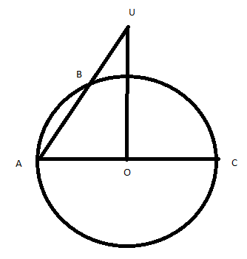
3a. O is the center of the circle with diameter AC, radius 1. B is a point on the circle and AB is extended to P with BP=1. Let S be the set of points P. If U is in S and UO is perpendicular to AC, find UO.

Slide 18
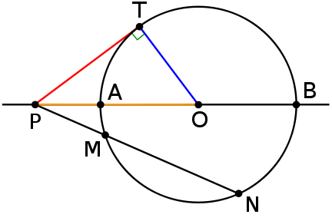
3b. V is in S and VC is perpendicular to AC. Find VC.
Power of a Point Theorem
$$PT^{2}=PM⋅PN$$

Slide 19
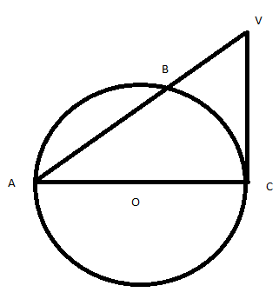
3b. V is in S and VC is perpendicular to AC. Find VC.

Slide 20
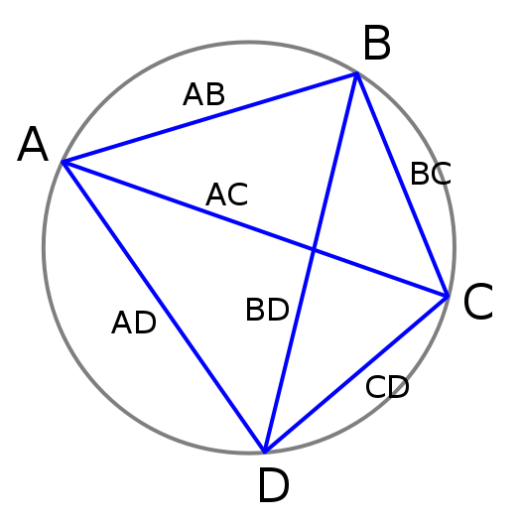
3c. Do all points in S lie on one circle?
Ptolemy’s Theorem
(AB)(CD) + (AD)(BC) = (AC)(BD)

Slide 21
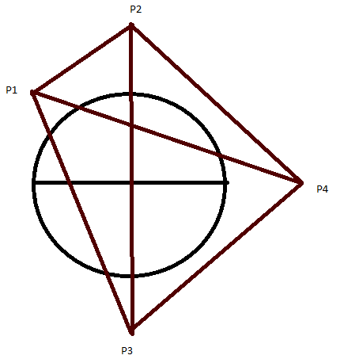
NO.
3c. Do all points in S lie on one circle?

Slide 22
4a. $f\left(x\right)=\left(x+\frac{1}{x}\right)−\left\lfloor x+\frac{1}{x}\right\rfloor , x>0$. Determine all x such that $f\left(x\right)=x$.

Slide 23
4b. Suppose that $x=\frac{a}{a+1}$ for some integer $a>1$. Prove $x≠f(x)$ but $f\left(x\right)=f\left(f\left(x\right)\right).$

Slide 24
4c. Prove that there are infinitely many rational numbers u, $0<u<1$, so that $u, f\left(u\right), f\left(f\left(u\right)\right)$ are all distinct and $f\left(f\left(u\right)\right)=f\left(f\left(f\left(u\right)\right)\right).$
I don’t know how to do this problem either :(

